Slide 1
Advanced Angular
Fundamentals
Lecture 1
By James(Jin) Wang
11/15/2021

Slide 2
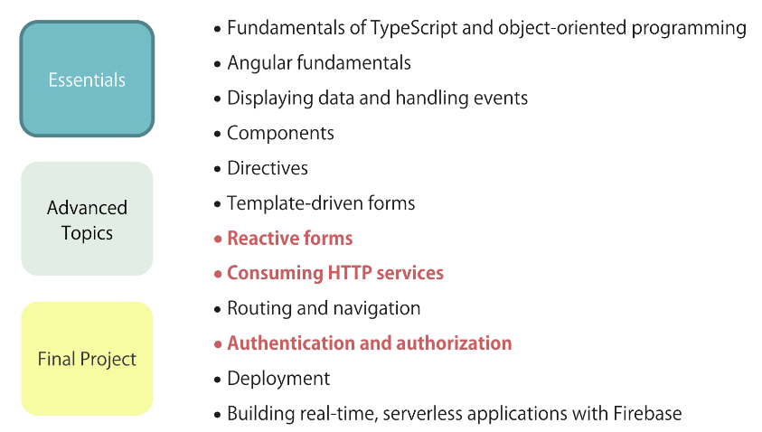
Big Picture

Slide 3
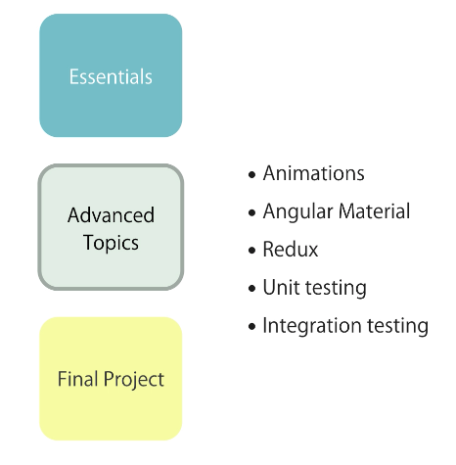
Big Picture

Slide 4
Outline
Study Guide
Setup environment
Components
Templates
Directives
Services

Slide 5
Study Guide
  Coding Practice
  Online Courses
  Interview Prep
  Portfolio

Slide 6
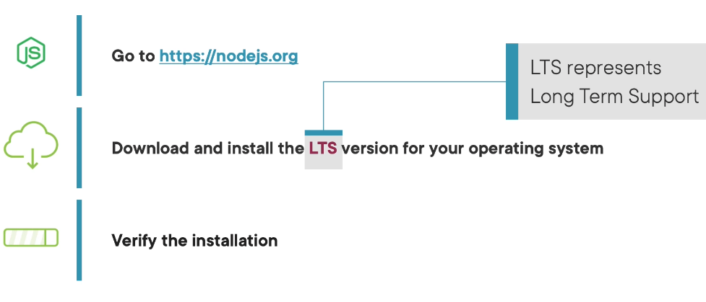
Setup
  Install NodeJS:

Slide 7
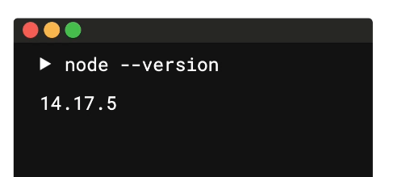
Setup
  Check NodeJS verion:

Slide 8
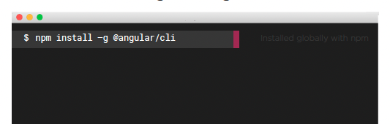
Setup
  Install Angular CLI:
  Verify version:
  ng --version

Slide 9
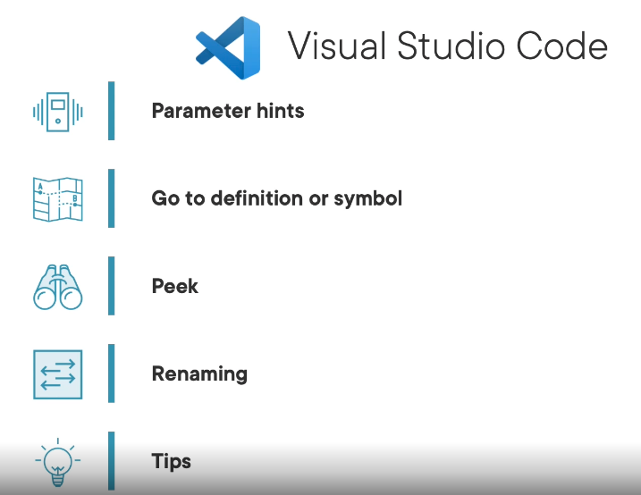
Setup
  Install VSCode:
  https://code.visualstudio.com/

Slide 10
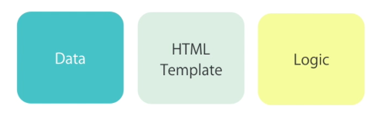
Components
  Component:

Slide 11
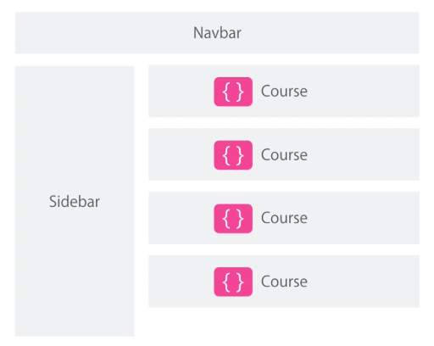
Components
  Component example:

Slide 12
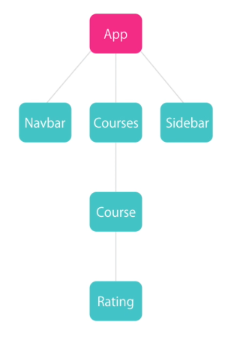
Components
  Component example:

Slide 13
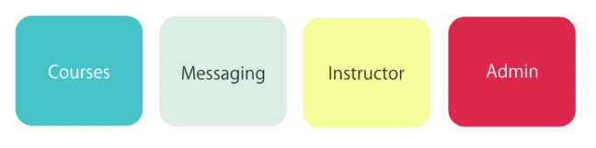
Components
  Modules:

Slide 14
Components
  How to use a component?
  Create a component
  Register it in a module
  Add an element in an HTML markup

Slide 15
Demo
  ng new hello-world
  ng serve -o
  ng g c courses
  Add Components:
  add <app-courses> to app.component.html
  Add Directives:
  add *ngFor to courses.component.html

Slide 16
Demo
  Add Service:
  ng g s service/courses
  Dependency Injection:
  add service to constructor of courses.component.html
  let service = new CoursesService();
  this.courses = service.getCourses();

Slide 17
Summary

Slide 18
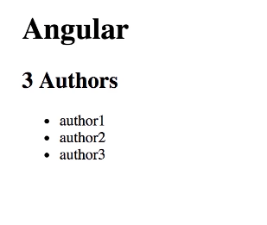
Assignment
  1. Use what you’ve learned in this section to display the list of authors.
  Q: How would you use the ngFor directive to display the list of authors?

Slide 19
Self Study
  Angular: The Big Picture
  https://app.pluralsight.com/library/courses/ng-big-picture
  Angular: Getting Started
  https://app.pluralsight.com/library/courses/angular-2-getting-started-update

